Slide 1


Slide 2

Business Intelligence
Nishika Jayasinghe

Slide 3
Week 1_Day_1_Introduction
Welcome
Introduce Class Contract
Attendance Marking
Course Introduction
Activity
Introduce Assessments

Slide 4
Class contract
Attendance
Class starting time
Class finishing time
Assessment draft feedback and submissions
AI use and similarity score
APA referencing and use of articles for assessment writing
Writing assessments- use of proxy writer or use of AI for writing assessments

Slide 5
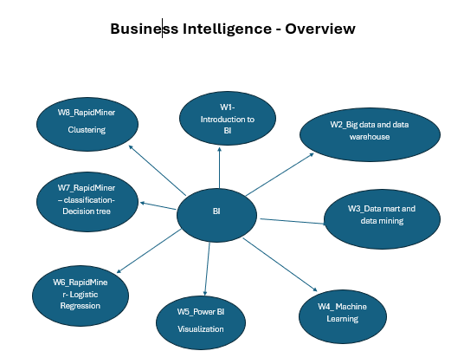
Course Introduction

Slide 6
Activity-"Data Detective" Challenge
You need to write down the following data into the paper individually
Name
Favorite app or website they use daily
One skill they want to learn in this course
Preferred way of learning (e.g., videos, reading, hands-on)
One random fact about themselves (fun "metadata")
Make three-member group and you need to
Share your data
Identify trends and categories (e.g., most popular apps, common goals, learning styles)
Come up with one insight or visualization idea (e.g., “70% of our group prefers hands-on learning”)

Slide 7
Activity-"Data Detective" Challenge
Present your findings
An interesting observation or "business insight" they derived
Sketch a basic bar chart or pie chart on the board or paper
What did you learn????

Slide 8
APA referencing and use of articles for assessments writing
https://aut.ac.nz.libguides.com/APA7th
https://www.canterbury.ac.nz/study/study-support-info/citations-and-referencing/apa-style
https://studentsupport.op.ac.nz/assets/Uploads/files/APA-7th-updated-quick-guide-2024.pdf

Slide 9
Homework
Read the following articles – Useful for writing assessment 1 and 2. Complete your work by Tuesday week 2. You need to make a summary of these articles.
https://moodle.futureskills.co.nz/mod/resource/view.php?id=70977
https://moodle.futureskills.co.nz/mod/resource/view.php?id=74143
https://moodle.futureskills.co.nz/mod/resource/view.php?id=74139

